Slide 1



Incidence, presentation and management of enteric leaks after Omega Loop Gastric By-pass (OLGB)
L Genser (2), A Soprani(1,2), O Sibaud (1), J Godfroy (1), J Cady (1)
1- Clinique Geoffroy Saint Hilaire (Paris),
2- Service de Chirurgie Digestive et Hépato-Bilio-Pancréatique, Pitié Salpêtrière (Paris)

Slide 2
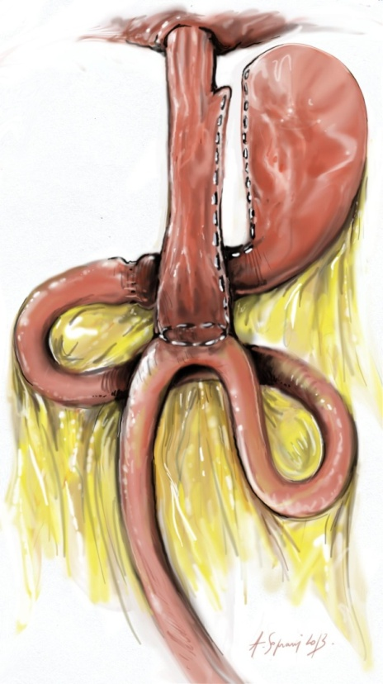
INTRODUCTION (1)
The incidence of leaks after OLGB is low.
But controversies about the relative safety of this procedure remain:
« anastomotic leak is much easier to manage after Roux-en-Y reconstruction, because it doesn’t have the large volumes of bilio-pancreatic secretions that occur with the loop reconstruction » (Griffen et al.1977, 186)
Gastro-jejunal anastomosis
Bilio-pancreatic secretions

Slide 3
INTRODUCTION (2)
First author; year | number | Leak (%) | location | reoperation | Conservative management** | Same H° | Death
Rutledge 2005 | 2 410 | 26 (1%) | ? | 26/ Coelio | 26 |  | 0
Wang 2005 | 423 | 9 (2%) | ? | 3 /Coelio | 9 | ? | 1
Carbajo 2005 | 209 | 4 (2%) | ? | 0 | 4 | 4 | 0
Chevalier 2008 | 350 | 1 (0.3%) | GJA* | laparotomy | 1 | 0 | 0
Noun 2012 | 1 000 | 5 (0.5%) | Gastric pouch | 2 | 4 (1 Y conversion) | 3 | 0
Lee 2012 | 1 163 | 15 (1.3%) | ? | ? | ? | ? | ?
Musella 2013 | 974 | 10 (1%) | 5 gastric pouch 3 GJA 2 RS | 6 | ? | 10 | 1
Current study | 2 319 | 35 (1.5%) | 11 gastric pch 4 GJA 20 uncertain loc | 28 /coelio 3 /lapatomy | 35 | ? | 0
**OLGB preservation during emergecy procedure
* GastroJejunal Anastomosis
✦ Remnant Stomach

Slide 4
METHOD (1)
2005-2013: 2 321 OLGB
Methylene blue test during initial operation
Systematic UGI series day-1 after surgery
During reintervention for leak management, surgical procedure consisted in:
  Indentification of leak
  Suture of leak when it was possible
  Placement of 2 irrigating closed suction drains around the site of the leak
Drains were left in situ (undercalibrated 10 days later) with sytematic irrigation-aspiration with acid lactic or saline serum.

Slide 5

METHOD (2)
CLASSIFICATION OF LEAKS (CADY/SOPRANI)
Type 1: leakage arising from the gastric stapler line of the gastric pouch
Type 2: Gastrojejunal anastomosis (GJA)
?
Type 3: Uncertain location (unidentifiable location on CT and intraoperatively)

Slide 6
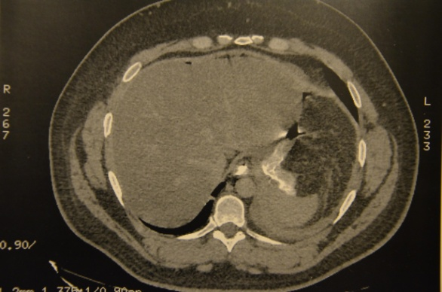
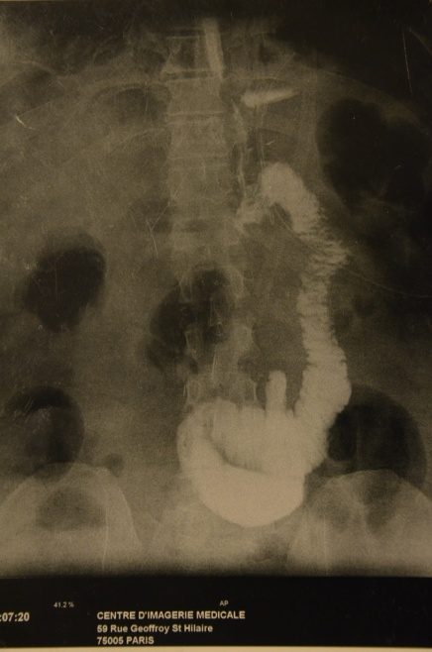
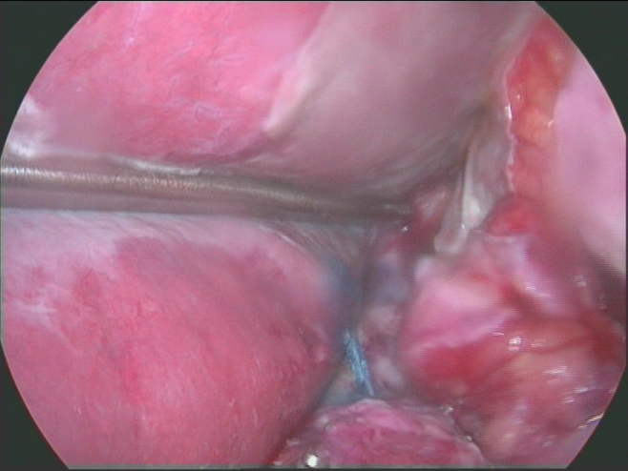
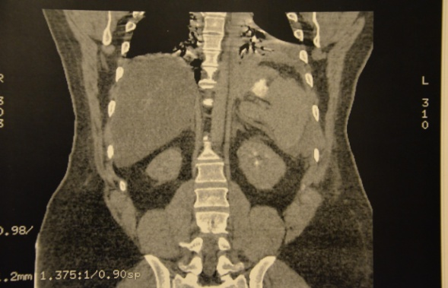
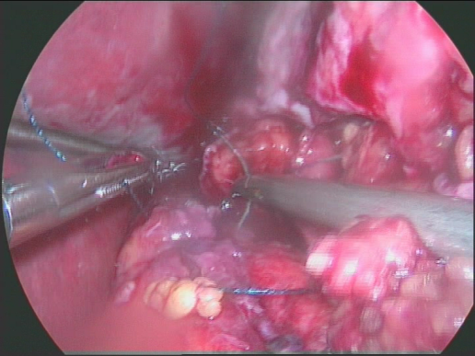
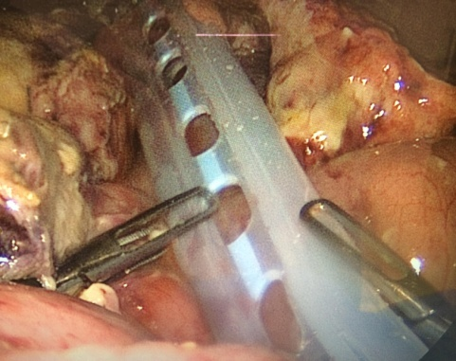
METHOD (3)
Type 1: diagnosis (day 2 after OLGB)
PER-OPERATIVE BLUE TEST
UGI (Day 1)
Type 1: surgical laparoscopic management: suture + drainage

Slide 7
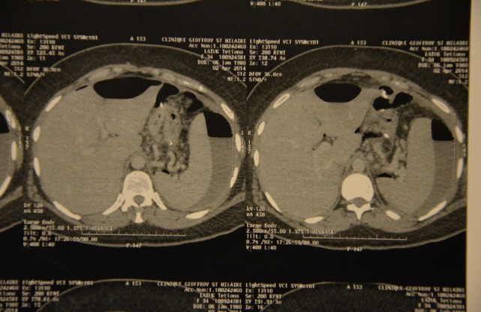
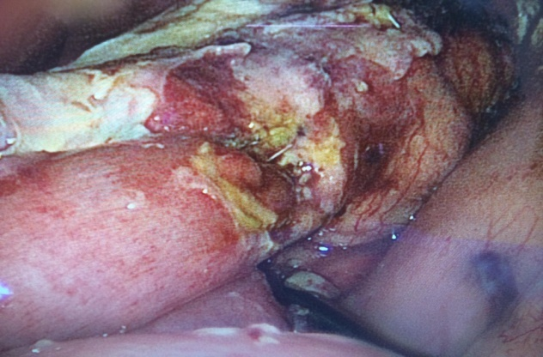
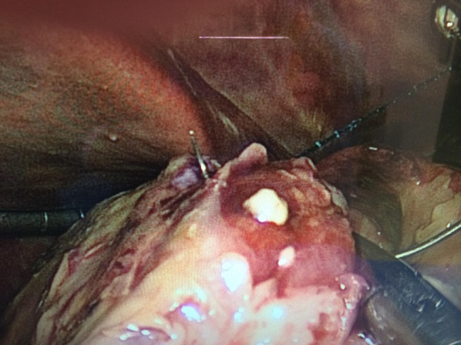
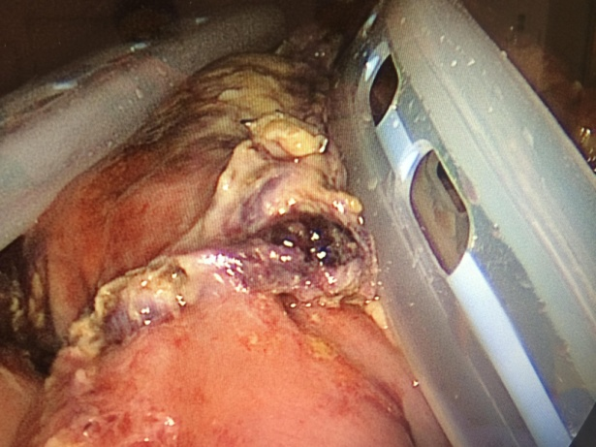
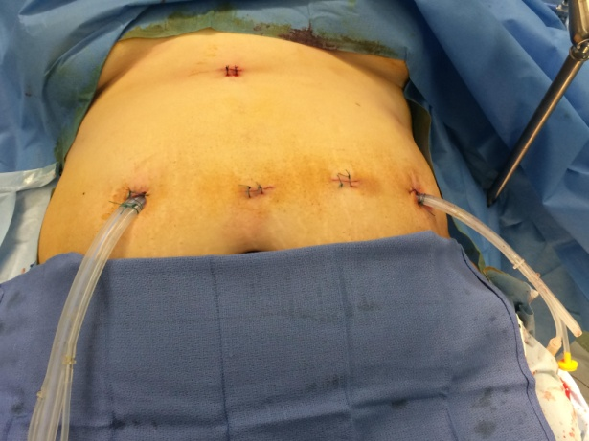
METHOD (4)
TYPE 2: Diagnosis (day 2 after OLGB)
*
▲
Helical CT with indirect signs
TYPE 2: surgical laparoscopic management

Slide 8
RESULTS (1) RISK FACTORS OF LEAK
Table 2 : Univariate analysis of factors associated with leaks after OLGB in 35 patients
 | Leaks (n=35) | Without leaks (n=2286 ) | P value
Male gender n (%) | 8 (23) | 378 (16) | 0,3
age>50 | 5 (14) | 671 (29) | 0,059
Revisional surgery | 17 (48) | 862 (37) | 0,21
One step (LAPGB rem-OAGB) | 13 (0.4) | 686 (30) | 0,35
Second hand patient | 10 (29) | 359 (15) | 0,05
Type 2 diabetes | 5 (14) | 289 (12) | 0.79
SAOS | 6 (17) | 250 (11) | 0.26
HTA | 14 (0.4) | 514 (22) | 0.003
Severe nicotism | 8 (23) | 151 (6) | 0.001
BMI groups (kg/m²)
35- 40 | 9 (25) | 435 (19) | 0.28
40-45 | 14 (40) | 932 (40) | 1
45-50 | 6 (17) | 440 (20) | 1
50-55 | 5 (15) | 399 (18) | 0.82
>55 | 1 (3) | 80 (3) | 1

Slide 9


RESULTS (2)
UGI postoperative day 1
LOW SENSIBILITY for enteric leaks location: 11.4%
COMPUTED TOMOGRAPHY WITH WATER SOLUBLE CONTRAST
100% specificity for indirect signs of leak
33% specificity for leak location

Slide 10

RESULTS (3) LOW RATE OF ENTERIC LEAKS (1.5%)
Enteric leaks: 35 / 2 321 (1.5%)
Type 1: 32%
LOCALIZED PERITONITIS
PLEURAL EFFUSION
?
Type 3: 57%
Type 2: 11%
GENERAL PERITONITIS
 | Type I (31.4%) | Type II (11.4%) | Type III (57.2%) | p
Subphrenic abces / CT done | 6 / 9 | 0 / 3 | 10 / 19 | p=0.06
Pleural effusion | 63% | 0% | 5% | p<0,01
Generalized peritonitis | 20% | 50% | 10% | p=0,08
Localized peritonitis | 80% | 50% | 90% | p=0,08
Delay of surgical management | 6+/-6.6(0-19) | 2.5+/-5.1(1-12) | 14+/-14.4(2-61) | 2vs3 0.03

Slide 11
RESULTS (4) (MORTALITY= 0)
CONSERVATIVE MANAGEMENT
SURGICAL MANAGEMENT
Only Type 3 (n=5)
Type 1; 2; 3 (n=30)
2 laparotomy
Generalized peritonitis
1.Richter hernia with bowel obstruction and large desunion of the stapler line (D-8)
2. Type 3 with multifocal abces (D-12)
Percutaneous drain
n=3
Septic syndrom and none or minimal septic repercussion underwent an helical-CT with subphrenic abces without gastrographin extravasation
28 coelio (93%)
Medical management
n=2
⇧
30% developed well drained chronic fistula into the irrigation drainage system with complete healing in all patients

Slide 12

DISCUSSION (1)
35 / 2 321 (1.5%) abces or intra-abdominal sepsis after OLGB
Lower rate of GJA leak after OLGB:
  A tension free anastomosis,
  A good blood supply by the gastric pouch,
  An uninterrupted jejunal loop

Slide 13
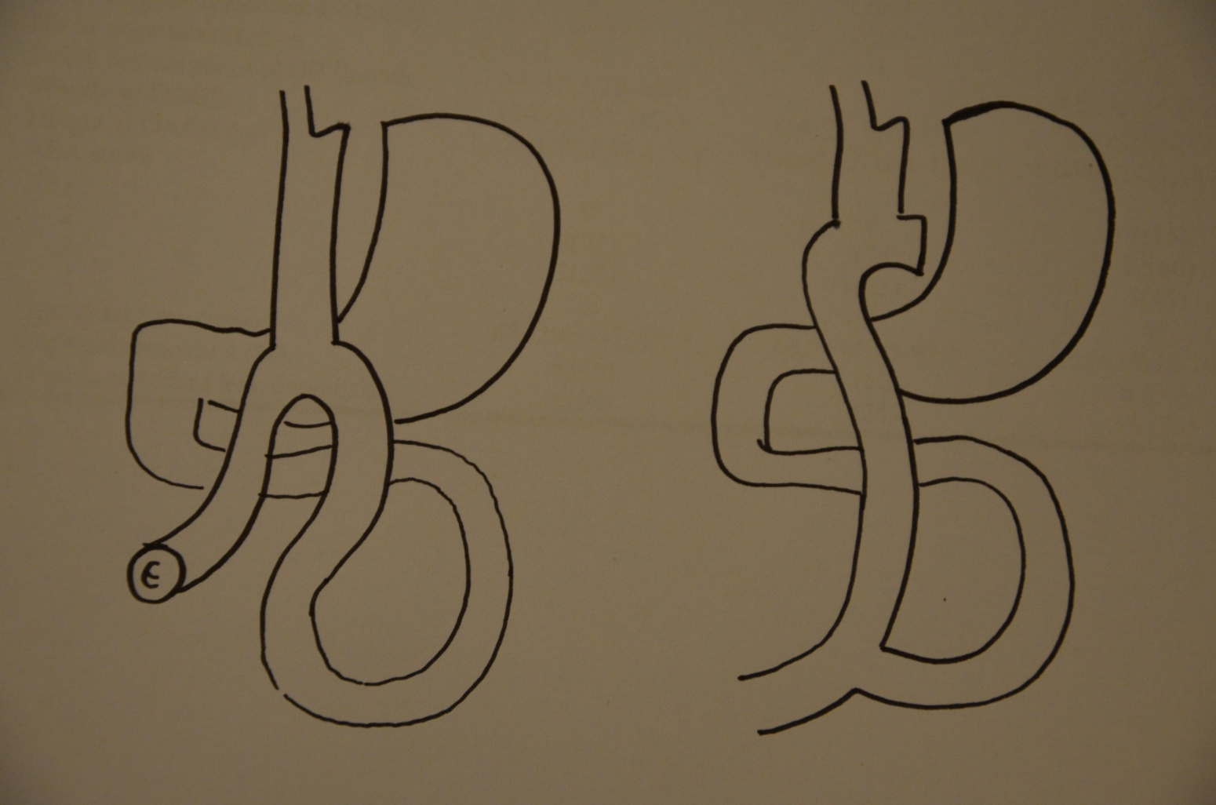
ENTERIC LEAK LOCATION OLGB vs RYGBP
DISCUSSION (2)
Type 1(32%)
Type 3(57%)
Type 2(11%)
GJA 80%
The most common site of leak after OLGB is arising from the gastric stapler line
The most common site of leak after RYGBP is at the gastrojejunal anastomosis

Slide 14
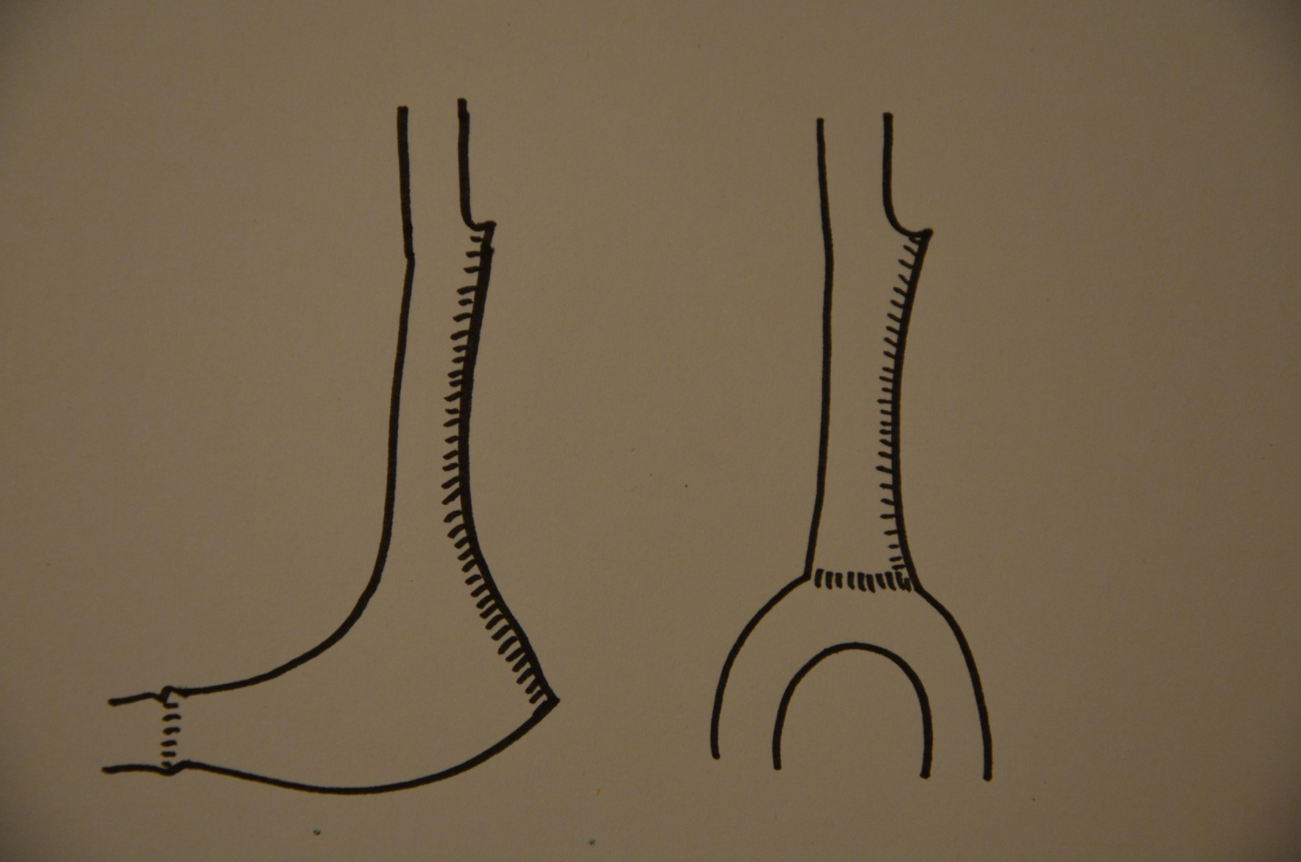

Existence of few similitaries between OLGB and Sleeve
DISCUSSION (3)
NO STENT!
New alternative: double pigtail
P
P
Sleeve Gastrectomy
OLGB

Slide 15
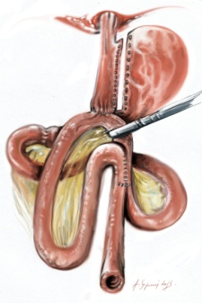
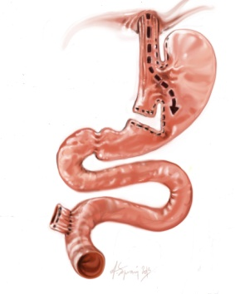
CONCLUSION
The incidence of enteric leaks after OLGB is low (1.5%)
Type 3 > Type 1 > Type 2
Type 1 and Type 3: localized peritonitis +/- pleural effusion
Type 2: Generalized peritonitis
Management (early diagnosis)
LAPAROSCOPY (28/30) (laparotomy)
LAVAGE / SUTURE / DRAINAGE
Gastrostomy / jejunostomy
Roux-N-Y conversion
Reversal procedure

Slide 16
Incidence, presentation and management of enteric leaks after Omega Loop Gastric By-pass (OLGB)
L Genser (2), A Soprani(1,2), O Sibaud (1), J Godfroy (1), J Cady (1)
1- Clinique Geoffroy Saint Hilaire (Paris),
2- Service de Chirurgie Digestive et Hépato-Bilio-Pancréatique, Pitié Salpêtrière (Paris)

