Slide 1





Conversion of Omega Loop Gastric Bypass to Roux-en-Y for management of refractory bile reflux: results in 47 patients
L Genser (2), A Soprani(1,2), Tabbara M (2), J Cady (1)
1- Clinique Geoffroy Saint Hilaire (Paris),
2- Service de Chirurgie Digestive et Hépato-Bilio-Pancréatique, Pitié Salpêtrière (Paris)
Notes:
Thank you ….
So today I will show you the results of a retrospective study concerning 879 patients who underwent

Slide 2
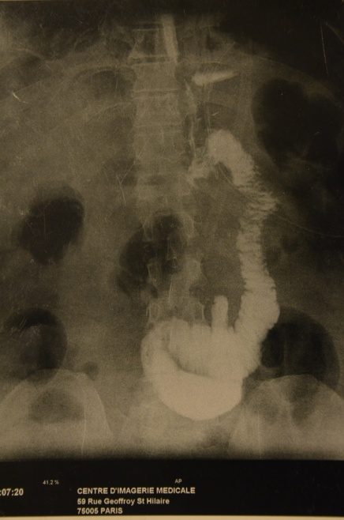
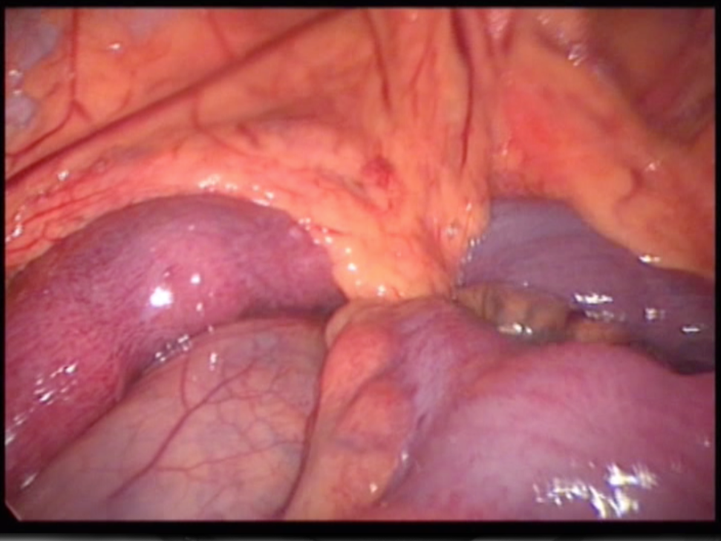
Introduction (1):
Why OLGB
Personal experience:
Leaks
4% after RNY (n=270) versus 1.5% (<2%/year) after OLGB (n=2321)
Internal hernia: never after OLGB
Dumping syndrom ?
GJA
Araising from the stapler line
of the gastric pouch
LEARNING CURVE +++
Wei-Jei Lee et al. Ann Surg 2005
Petersen Hernia

Slide 3
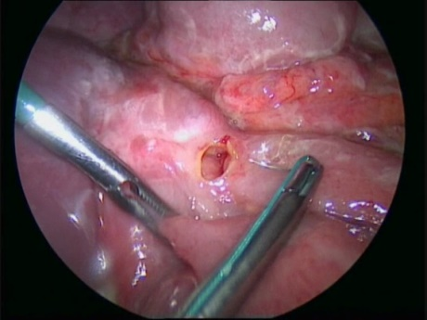
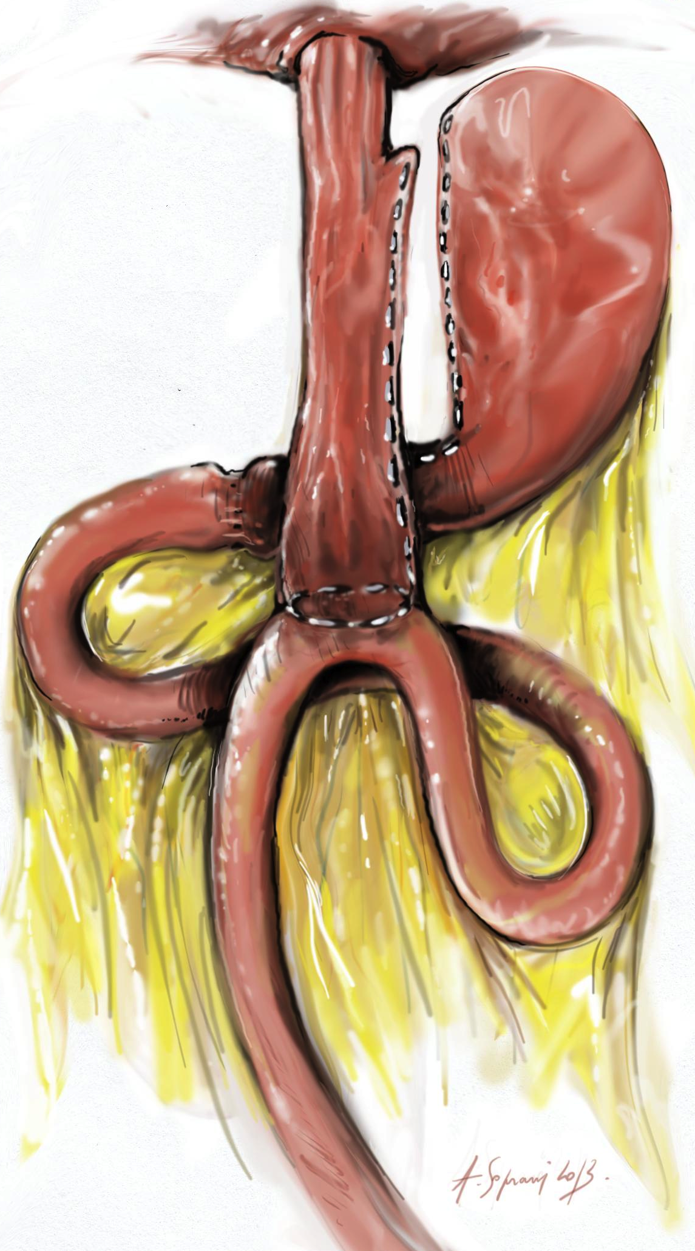
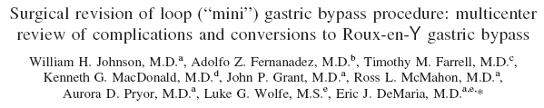
Introduction (2):
OLGB Controversies
MARGINAL ULCER
Controversies exist concerning Potential side effects of OLGB
  Intractable Bile Reflux
  Malnutrition
  Marginal Ulcer
%?
« the number of complications and the revision rate after the MGB procedure have clearly been underreported »
BILE REFLUX
Notes:
First
We know
Such as

Slide 4
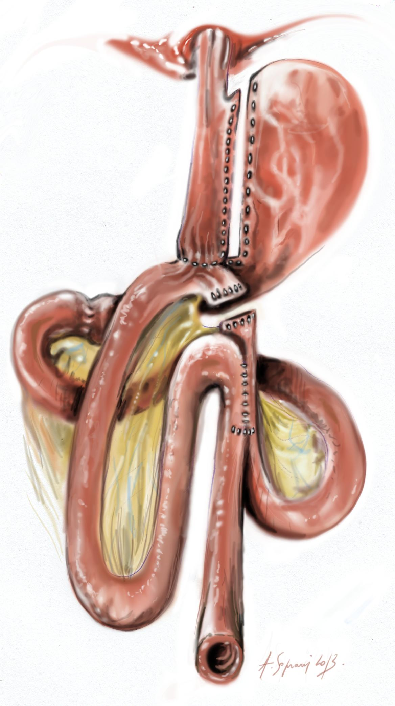
Methods (1)
From 2005 to February 2014
N=2321 OLGB
Analyze:
  Intractable Bile reflux rate after OLGB requiring revisional procedure
  Roux-en-Y conversion feasability and outcomes
  Identification of predictive factors for Bile Reflux after OLGB
Notes:
So from
among them 879 were revisional OLGB after failed GB either in one or two step.
We retrieved all the data and focused on

Slide 5
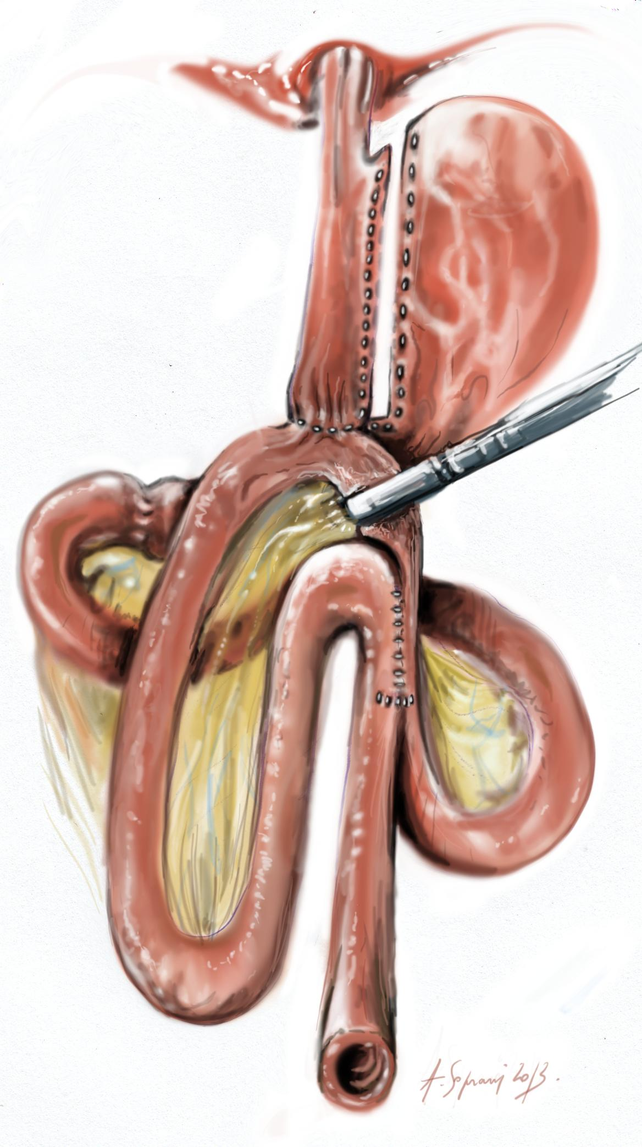
Methods (2)
Roux-en-Y conversion procedure
A
B
Second step of LÖNROTH procedure
A-B: 90 cm

Slide 6
Results (1)
Baseline characteristics of OLGB patients who presented intractable bile reflux requiring Roux Y conversion (n=47)
OLGB (2005-2014) | n = 2321
Symptomatic Bile Reflux | 116 (5%)
Refractory Bile Reflux (RBR) to medical treatment | 47 (2%)
OLGB – RNY Conversion | 47
Delay OLGB – RNY Conversion (months) | 22.5
BMI at conversion (kg/m2) | 29.1

Slide 7
Results (2)
Roux-en-Y conversion
Short term post-operative outcomes (n=47)
Conversion to laparotomy | 0
Mortality | 0
Early post-operative complication (n)% | 1 (2,1)
Bleeding | 1
LOS (days) | 5

Slide 8
Results (3)
Roux-en-Y conversion
Long term post-operative outcomes (n=47)
Follow up (months) | 25.9
Late post-operative complications (≥30 days) n (%) | 4 (8.5%)
marginal ulcer | 3
Richter Hernia | 1
Malabsorptive syndroma | 0
RBR resolution | 47 (100%)

Slide 9
Results (4)
Pre-OLGB Baseline characteristics (n=47)
Sex ratio H/F (n) | 1/46
Age at OLGB (years)* | 46.9±10.7*
Weight at OLGB (kg)* | 105±15
BMI (kg/m²)* | 40.8±5.1
OLGB after Gastric Banding failure n (%) Insufficiant EWL n(%) Esophageal dilatation n(%) Reflux n(%) | 29 (62) 25 (86) 2 (6.9) 2 (6.9)
Delay AGB- OLGB (months)* | 72.8±28.9
Obesity related diseases Arterial hypertension n(%) Dyslipidemia n(%) Type 2 diabetes n(%) SAS n(%) Depression n(%) Severe Nicotism n(%) | 9 (19) 5 (10) 2 (4.2) 6 (13) 7 (15) 1 (0.02)

Slide 10
long term complications after primary OLGB Vs revisional OLGB
Impact of LAGB:
Results (5)
 | Primary OLGB (n = 1440) | Revisional OLGB (n = 881) | P value
Long term complications requiring revisional surgery | 19 (1.3%) | 36 (4%) | p<0,001
- Malnutrition (reverse) | 13 (0,9) | 7(0,8) | 1
- Intractable Bile reflux (conversion Y) | 6 (0,4) | 29 (3,3) | p<0,001
Notes:
Concerning long complications requiring ROLGB in comparaison to primary OLGB
The overall rate of long term complication was significantly higher in revisional OLGB group because of higher rate of intractable bile reflux after ROLGB
surgical management of intractable bile reflux is RY conversion. It is the second surgical step of RYGB described by Lonroth, and the results of RY conversion after MGB for intractabile bile reflux will be presented in the next speech by my collegue dr soprani
The rate of Malnutrition requiring one of our two reverse procedure was the same between groups.

Slide 11
Discussion
Why restrictive procedure before OLGB
increases the risk of Bile Reflux?
⇧
⇧

Slide 12


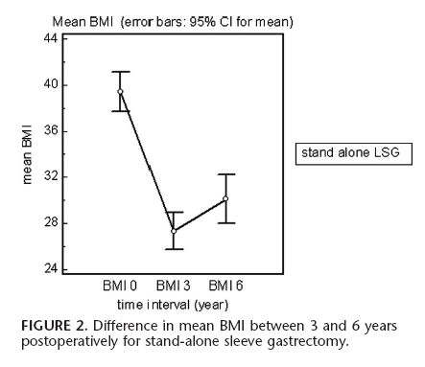
Discussion (1)
OLGB after LSG for weight loss failure?
Esophagogastric junction enlargement
« LSG appears to be associated with weigh regain and quite often with reflux symptoms in long term follow up »
Conversion LSG to OLGB for weight loss failure is not indicated:
Esophagogastric junction disruption
Intractable bile reflux +++

Slide 13
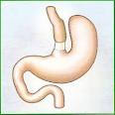
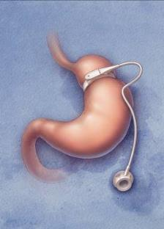
Discussion (2)
Intractable Biliary reflux after LAGB: WHY?
Restrictive operations = increased Intra Bolus Pressure (IBP)
  → repetitive esophageal contraction
  → transhiatal enlargement
Anatomic or physiologic disruption of the esophagogastric junction
+/- esophageal motor disorders
C Cruiziat et al. Digestive and Liver Disease 2010
Notes:
Why…is associated with?
Furthermore We know that some retrictive bariatric procedures are potentially associated with physiologic and anatomic Oesophagogastric junction disruption and high oesocardial pressure which can be responsible for intractable bile reflux occurrence after revisional OLGB.
After sleeve gastrectomy with Gastroesophageal refux disease, we observed that conversion to OLGB was not a good indication that is why we prefer RYGB in case of GERD.

Slide 14
Conclusion (1)
Conversion of OLGB to Roux-en-Y is :
  Feasible
  Acceptable
      Low post-operative morbidity
      Refractory Bile Reflux always cured
  Rarely necessary (2%)
Notes:
Low morbidity: not higher than primary OLGB and RYGB
Rate of intractable bile reflux after revisional OLGB is low (3.3%)

Slide 15

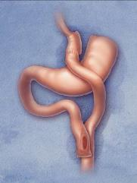
Conclusion (2)
Identification of patients at risk of intractable bile reflux
After Revisional OLGB ?
Before OLGB: Esophageal manometry; 24-h pH testing
Anatomic or physiologic disruption of the esophagogastric junction?
RYGB
Notes:
according to our experience so that to better identify patients at risk of intractable biliary reflux after revisional OLGB for failed gastric banding
We think that oesophageal manometry and 24 hours pH testing before ROLGB could be interresting to identify anatomic or physiologic disruption of esophagogastric junction.
And for these patients, we recommend a RYGB

Slide 16
Conversion of Omega Loop Gastric Bypass to Roux-en-Y for management of refractory bile reflux: results in 47 patients
L Genser (2), A Soprani(1,2), Tabbara M (2), O Sibaud (1), A Torcivia (2), J Godfroy (1), JM Siksik (2), J Cady (1)
1- Clinique Geoffroy Saint Hilaire (Paris),
2- Service de Chirurgie Digestive et Hépato-Bilio-Pancréatique, Pitié Salpêtrière (Paris)
Acknowledgements: ARCEC, Hadrien Soprani
Notes:
Thank you ….
So today I will show you the results of a retrospective study concerning 879 patients who underwent

Slide 17
jeancady@wanadoo.fr
antoinesoprani@hotmail.com
laurent.genser@gmail.com
Centre Multidisciplinaire de Chirurgie de l’obésité
(CMCO)

