Slide 1





Revisional Omega Loop Gastric Bypass after Failed Gastric Banding:
A Retrospective Study of 879 Patients
L Genser (2), A Soprani(1,2), Tabbara M (2), J Cady (1)
1- Clinique Geoffroy Saint Hilaire (Paris),
2- Service de Chirurgie Digestive et Hépato-Bilio-Pancréatique, Pitié Salpêtrière (Paris)
Notes:
Thank you ….
So today I will show you the results of a retrospective study concerning 879 patients who underwent

Slide 2
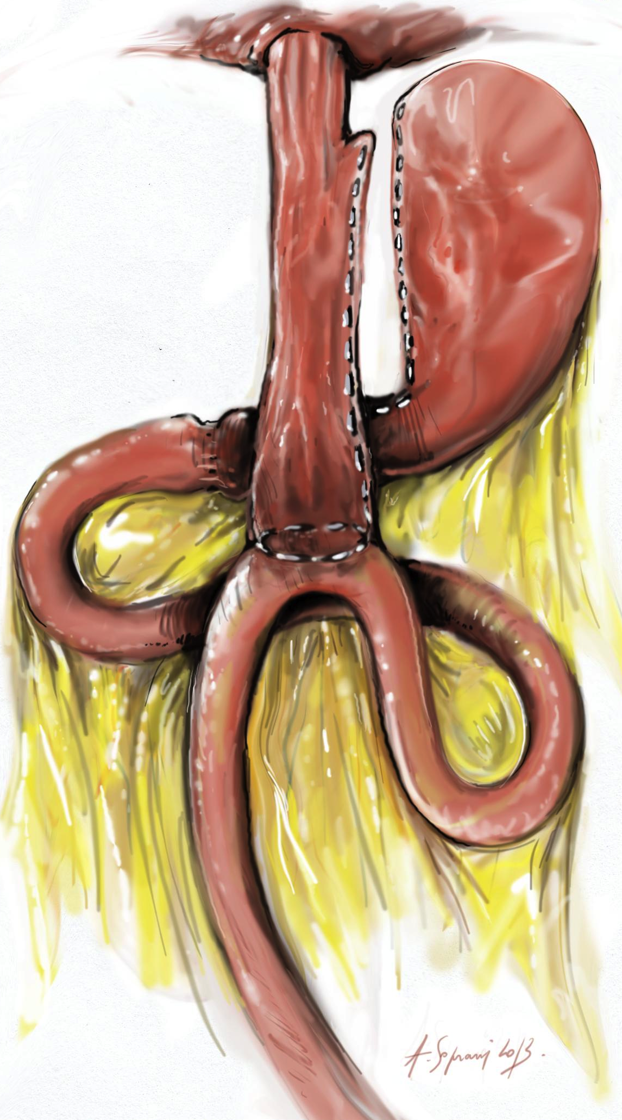
Introduction
Efficiency of OLGB as both restrictive and malabsorptive bariatric procedure has been demonstrated.
« Weight loss after revision of pure restictrive operations is significantly better than after revision of operation with malabsorptive components »
However, controversy exists concerning side effects of OLGB
  Intractable Bile Reflux
  Malnutrition
  Marginal Ulcer
?
Brolin and Cody Ann Surg 2008
Notes:
First
We know
Such as

Slide 3
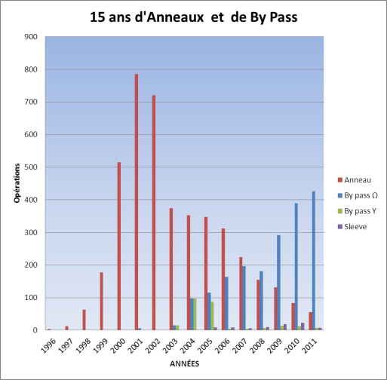
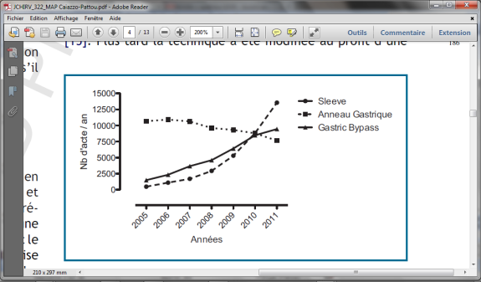
Introduction
Distribution of Bariatric procedures ( LAGB, OLGB, RYGB, SLEEVE )
in Geoffroy Saint Hilaire
LAGB
OLGB
Lazzati et al , SOARD 2014
Notes:
In GSH bariatric surgery is performed for more than 15 years
Like many french and internationnal centers surgeons are used to place and then remove many gastric bandings. Because of GB failure the surgeons decided to switch to OLGB which has become the gold standard procedure in the department

Slide 4
Methods
From 2005 to January 2014
N = 2 319 OLGB
N = 879 Revisional OLGB after failed gastric banding
Analyze:
  Early postoperative complications requiring reintervention (leaks, bleeding, mechanical complications)
  Long term complications requiring revisional procedure (Intractable bile reflux, malnutrition, marginal ulcer…)
Notes:
So from
among them 879 were revisional OLGB after failed GB either in one or two step.
We retrieved all the data and focused on

Slide 5
Revisional OLGB after failed Gastric Banding between 2005 and 2014
Results (1)
OLGB | N = 2 319
Revisional OLGB | 879 (37%)
- One step OLGB-Band removal | 700
- two step procedure | 179
Notes:
Among the 879 Revisional OLGB for failed gastric banding which represent more than one third of our OLGB cohort!
700 underwent one step , and 179 2 step procedure

Slide 6
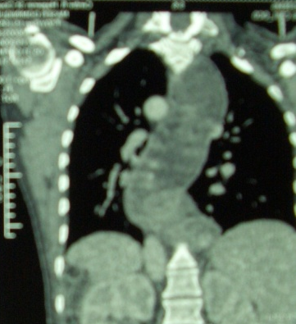
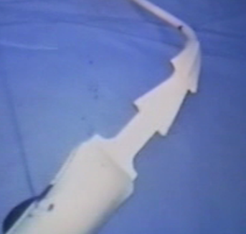
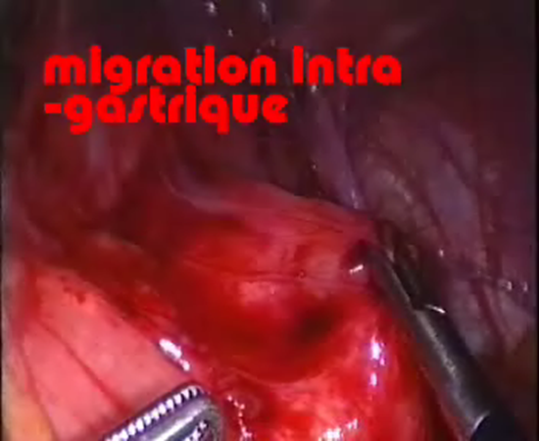
Reasons for revision?
Results (2)
Reasons | N (%)
Band related revision | 799 (90,9)
weigh loss failure* | 590 (67%)
prolapse | 110 (12.5%)
erosions | 24 (2.7%)
megaesophagus | 75 (8.5%)
Rupture band or port related revision | 80 (9.1%)
*Defined as < 25% excess weight loss within 2 years of follow up
Notes:
The reasons for revision were mainly band related and are comparable to other series.
Proloapse= slippage

Slide 7
Comparaison of baseline characteristics primary vs revisional OLGB cohort:
Results (3)
 | Primary OLGB (n=1440) | Revisional OLGB (n=879) | P value
Mean BMI (SD) | 39.5 (6.5) | 40.1 (6.1) | 0.561
Male gender | 230 | 136 | 0.789
Mean age (SD) | 38.5 (10.7) | 39.5 (9.6) | 0.586
diabetes | 185 | 110 | 0.676
Arterial Hypertension | 335 | 193 | 0.550
SAOS | 160 | 97 | 0.715

Slide 8
Short term complications after primary OLGB Vs revisional OLGB
Results (4)
 | Primary OLGB (n = 1440) | Revisional OLGB (n = 879) | P value
Short term complications with reintervention | 44 (3.2%) | 31 (3.3%) | 0,54
- leaks GJ Anastomosis From the gastric pouch Uncertain location | 19 6 2 11 | 16 5 2 9 | 0,38
- Intra abdominal bleeding | 12 | 9 | 0,65
- Mechanical complications Gastrojejunostomy stricture Richter hernia | 13 4 9 | 6 4 2 | 0,64
Notes:
We wanted to know if ROLGB wa associated with more short term complications in comparaison to primary OLGB?
The answer is no
As you can see we observed no difference in term of leaks/ intra abdominal bleeding or mechanical complications.
Rates were similar
ROLGB after failed GB does not impact on the occurrence of postoperative complication

Slide 9
1 or 2 step Revisional OLGB = more post operative complications ?
Results (5)
 | Primary OLGB N=1440 | 1 step-Revisional OLGB (N=700) | 2 step-Revisional OLGB (N=179) | P value (paired Comparaison)
Intra abdominal bleeding | 12 | 8 | 1 | NS
Mechanical complications | 13 | 5 | 1 | NS
Leaks | 19 | 13 | 3 | NS
Notes:
Does the sequence one or two step in the revisional procedure impact on the occurrence of complication
NO!
and As you can see there is no difference with the rest of our cohort, whatever paired comparaison
ROLGB after band removal either in one or two step is not associated with higher incidence of post operative complication
So do it in one step if it is possible

Slide 10
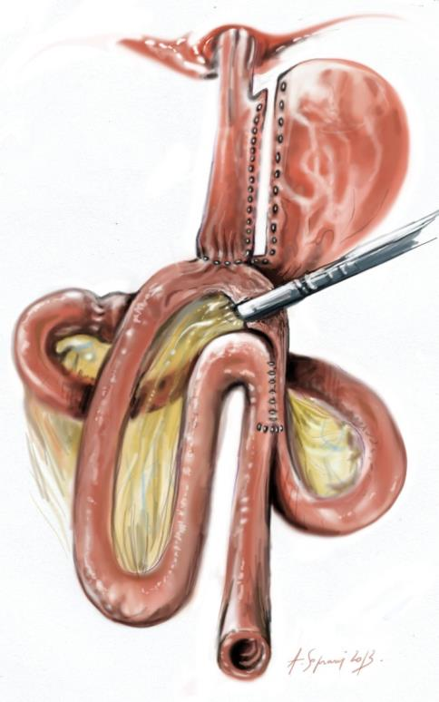
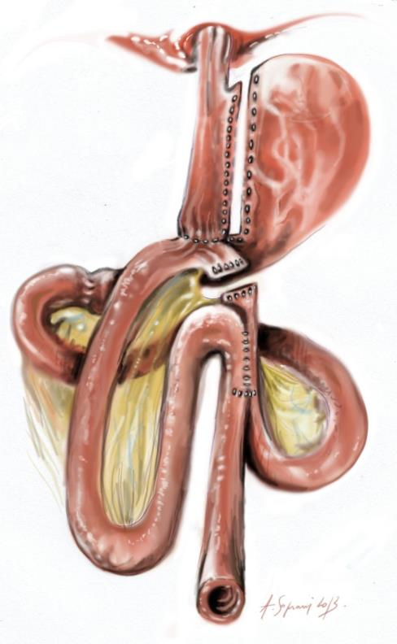
long term complications after primary OLGB Vs revisional OLGB
Results (6)
 | Primary OLGB (n = 1440) | Revisional OLGB (n = 879) | P value
Long term complications requiring revisional surgery | 19 (1.3%) | 32 (3.65%) | p<0,001
- Malnutrition (reverse) | 13 (0,9) | 7(0,8) | 1
- Intractable Bile reflux (conversion Y) | 6 (0,4) | 25 (2,8) | p<0,001
Conversion to Roux-N-Y
for intractable bile reflux:
Notes:
Concerning long complications requiring ROLGB in comparaison to primary OLGB
The overall rate of long term complication was significantly higher in revisional OLGB group because of higher rate of intractable bile reflux after ROLGB
surgical management of intractable bile reflux is RY conversion. It is the second surgical step of RYGB described by Lonroth, and the results of RY conversion after MGB for intractabile bile reflux will be presented in the next speech by my collegue dr soprani
The rate of Malnutrition requiring one of our two reverse procedure was the same between groups.

Slide 11
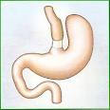
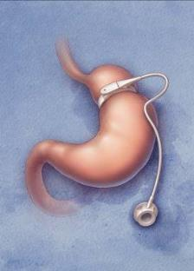
Discussion
Why revisional OLGB for failed LAGB→ Intractable Biliary reflux?
Restrictive operations = High eso-cardial pressure
  Gastric banding +++
  Vertical banded gastroplasty
Anatomic or physiologic disruption of the esophagogastric junction
+/- esophageal motor disorders
C Cruiziat et al. Digestive and Liver Disease 2010
Notes:
Why…is associated with? explanation
Furthermore We know that some retrictive bariatric procedures are potentially associated with physiologic and anatomic Oesophagogastric junction disruption and high oesocardial pressure which can be responsible for intractable bile reflux occurrence after revisional OLGB.
After sleeve gastrectomy with Gastroesophageal refux disease, we observed that conversion to OLGB was not a good indication that is why we prefer RYGB in case of GERD.
We guess ph/metry manometry if yes RY

Slide 12
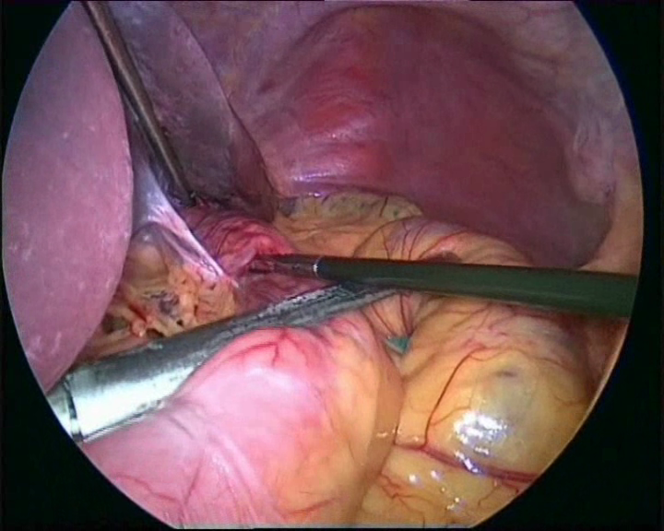
Conclusion
Revisional Omega Loop Gastric Bypass after Failed Gastric Banding:
  Feasible
  Acceptable
    Low post-operative morbidity (1 step # 2 step)
    Main Long term Complications requiring RY conversion : Intractable Bile reflux +++
Notes:
Low morbidity: not higher than primary OLGB and RYGB
Rate of intractable bile reflux after revisional OLGB is low (3.3%)

Slide 13
Revisional Omega Loop Gastric Bypass after Failed Gastric Banding:
A Retrospective Study of 879 Patients
L Genser (2), A Soprani(1,2), Tabbara M (2), J Cady (1)
1- Clinique Geoffroy Saint Hilaire (Paris),
2- Service de Chirurgie Digestive et Hépato-Bilio-Pancréatique, Pitié Salpêtrière (Paris)
Acknowledgements: ARCEC, Adrien Soprani
Notes:
Thank you ….
So today I will show you the results of a retrospective study concerning 879 patients who underwent

Slide 14

jeancady@wanadoo.fr
antoinesoprani@hotmail.com
laurent.genser@gmail.com
Centre Multidisciplinaire de Chirurgie de l’obésité
(CMCO)

Slide 15
Results (6)
Leaks after Revisional OLGB
 | N (%)
Number | 16/879(1.8%)
Mean time of appearance of leak (days) | 12± 9,3[0-35]
Location of leak - gastric tube (type 1) - gastrojejunostomy (type 2) - uncertain (type 3) | 5 (30) 2 (12) 9 (58)
Clinical Presentation
- generalized peritonitis | 3
- subphrenic abcess | 12
Conservative management / Radiological drainage Surgical conservative management | 1/ 2 13
Notes:
Looking at the leaks sub group
We saw that 16 patients had leaks, after ROLGB for failed GB , with the following charcteristics
Mean time was
More than half of these patients had intra abdominal abcess without fistula according to peroperative negative blue test.
All of these patients had successful conservative management whether radiological/ medical or surgical

Slide 16
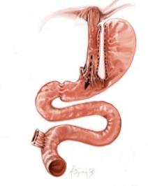
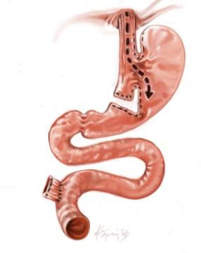
Revisional OLGB and bile reflux
Results (8)
 | Primary OLGB (n=1 440) | Revisional OLGB (n=879) | P value
Intractable bile reflux | 6 | 25 | p<0,001
Intractable bile reflux with severe malnutrition | 3 | 4 | 0,43
Conversion to LRYGB or Reversal procedure | 9 (0.6%) | 29 (3.3%) | p<0,001

Slide 17
Revisional OLGB and bile reflux
Results (8)
 | Primary OLGB (n=1 440) | Revisional OLGB (n=879) | P value
Intractable bile reflux | 6 | 25 | p<0,001
Intractable bile reflux with severe malnutrition | 3 | 4 | 0,43
Conversion to LRYGB or Reversal procedure | 9 (0.6%) | 29 (3.3%) | p<0,001
Notes:
Incidence of intractable bile reflux after revisional OLGB is significantly higher than after primary OLGB. Malnutrition was explained by delayed diagnosis of sever bile reflux and reversal procedure was sometimes necessary.

Slide 18

Revision to LRYGB for intractable bile reflux
A-B= 90 cm
A
A
A
B
B

Slide 19
Results (9)
Revision to LRYGB n = 35/2 319 (1.5%) between 2005 and 2013
 | N (%)
Conversion to laparotomy | 0
Mortality | 0
Early postoperative complication | 1 (2.8%)
Richter Hernia | 1
Reintervention | 1
Mean hospital stay | 5 days
Outcome of revision surgery | 3 (8.5%)
Anastomotic ulcer | 3
Malabsorptive syndrom | 0
Bile reflux resolution | 35 (100%)
Notes:
19
And since 2005 35 RY conversion for intractable biliary have been performed
We have reported :
no mortality and open conversion. And 100% resolution of with no malabsorption
The main outcome reported after RY conversion was marginal ulcer occurrence.

Slide 20
Discussion
Which procedure after failed restrictive surgery: OLGB or RYGB?
Notes:
Which procedure after restrictive procedure failure ? RY or OLGB
We reviewed main studies about revisional surgery for failed restrictive surgery .
After RYGB or OLGB, reoperation rate seems to be similar.
However, incidence of leak, anastomotic stenosis and bowel obstruction seems to be higher after RY.
With higher incidence of, intractable bile reflux requiring revisional procedure after OLGB whatever the study (3.3-5)
So it seems that we have the same rates of reintervention than RY, but for different kind of complications

